Slide 1

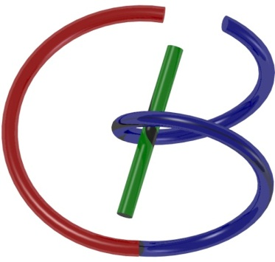
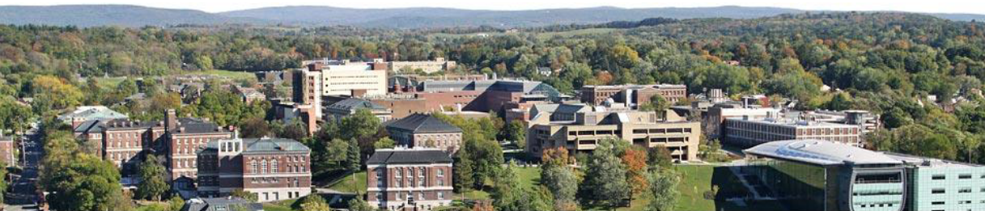
38655 BMED-2300-02
Lecture 14: CT Scanner
Ge Wang, PhD
Biomedical Imaging Center
CBIS/BME, RPI
wangg6@rpi.edu
March 9, 2018

Slide 2
BB Schedule for S18
Tue | Topic | Fri | Topic
1/16 | Introduction | 1/19 | MatLab I (Basics)
1/23 | System | 1/26 | Convolution
1/30 | Fourier Series | 2/02 | Fourier Transform
2/06 | Signal Processing | 2/09 | Discrete FT & FFT
2/13 | MatLab II (Homework) | 2/16 | Network
2/20 | No Class | 2/23 | Exam I
2/27 | Quality & Performance | 3/02 | X-ray & Radiography
3/06 | CT Reconstruction | 3/09 | CT Scanner
3/20 | MatLab III (CT) | 3/23 | Nuclear Physics
3/27 | PET & SPECT | 3/30 | MRI I
4/03 | Exam II | 4/06 | MRI II
4/10 | MRI III | 4/13 | Ultrasound I
4/17 | Ultrasound II | 4/20 | Optical Imaging
4/24 | Machine Learning | 4/27 | Exam III
Office Hour: Ge Tue & Fri 3-4 @ CBIS 3209 | wangg6@rpi.edu
Kathleen Mon 4-5 & Thurs 4-5 @ JEC 7045 | chens18@rpi.edu

Slide 3
CT Scanner
Data Truncation
CT Scanning
CT Generations
Spiral/Helical CT
Interior Tomography
CT Image Artifacts
Image Quality
Image Artifacts
X-ray Radiation Dose
Dose Measures
Low-dose CT

Slide 4
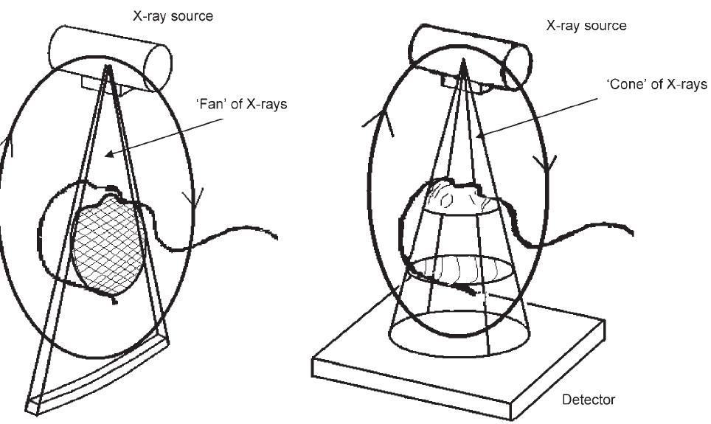

Sufficient Condition: 2D
At least a point on a source orbit
on any line in an object

Slide 5
Sufficient Condition: 3D
At least a point on a source orbit
on any plane in an object

Slide 6
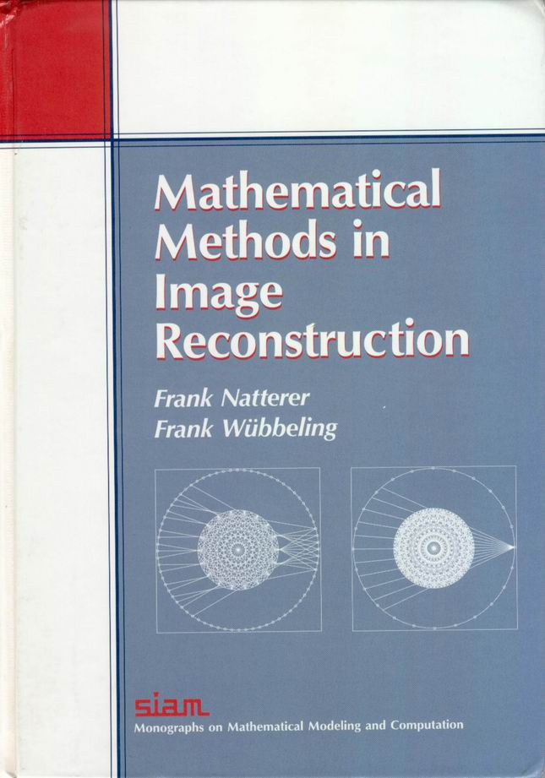
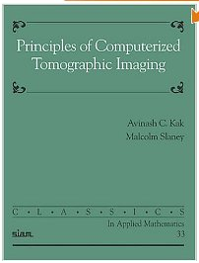


Classic Scheme / Central Dogma
A whole cross-section or an entire object must be completely covered by an x-ray beam (parallel-beam, fan-beam, or cone-beam)
Resultant data are transformed to the Fourier space that must be fully sampled for image reconstruction over the section or the object

Slide 7
CT Scanner
Data Truncation
CT Scanning
CT Generations
Spiral/Helical CT
Interior Tomography
CT Image Artifacts
Image Quality
Image Artifacts
X-ray Radiation Dose
Dose Measures
Low-dose CT

Slide 8
First Four Generations

Slide 9
Electron-beam CT

Slide 10
Seven Generations
Generation | Source | Source collimation | Detector | Detector collimation | Source-detector movement | Advantages | Disadvantages
1G | Single x-ray tube | Pencil beam | single | none | Move linearly and rotate in unison | Scattered energy is undetected | slow
2G | Single x-ray tube | Fan beam, enough to cover FOV | multiple | Collimated to source direction | Move linearly and rotate in unison | Faster than 1G | Lower efficiency and larger noise because of the collimation in detectors
3G | Single x-ray tube | Fan beam, enough to cover FOV | Many | Collimated to source direction | Rotate in synchrony | Faster than 2G, continuous rotation using a slip ring | More expensive than 2G, low efficiency
4G | Single x-ray tube | Fan beam, covers FOV | Stationary ring of detectors | Cannot collimate detectors | Detectors are fixed, source rotates | Higher efficiency than 3G | High scattering since detectors are not collimated
5G (EBTC) | Many tungsten anodes in single large tube | Fan beam | Stationary ring of detectors | Cannot collimate detectors | No moving parts | Extremely fast, capable of stop-action imaging of beating heart | High-cost, difficult to calibrate
6G (Single-slice Spiral CT) | 3G/4G | 3G/4G | 3G/4G | 3G/4G | 3G/4G plus linear patient table motion | Fast 3D images | A bit more expensive
7G (Multi-slice Spiral CT) | Single x-ray tube | Cone beam | Multiple arrays of detectors | Collimated to source direction | 3G/4G/6G motion | Fast 3D images | expensive

Slide 11
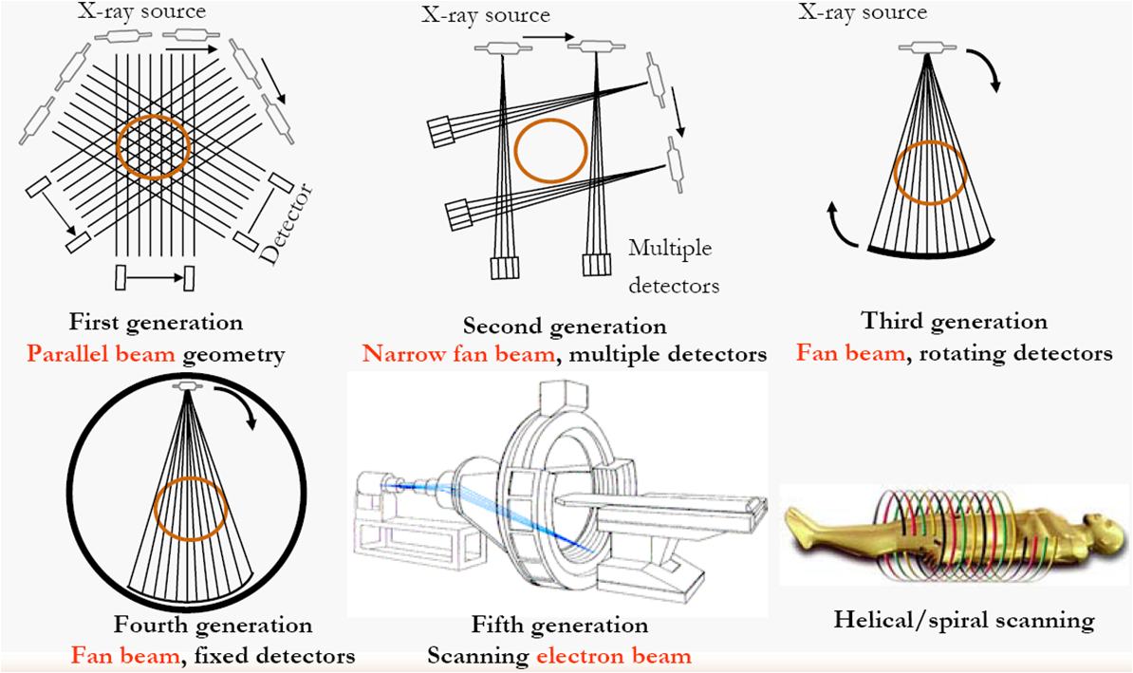
Scanning Modes
Projection data can be truncated transversely or longitudinally, which makes it difficult formulating the Fourier domain sampling patterns

Slide 12
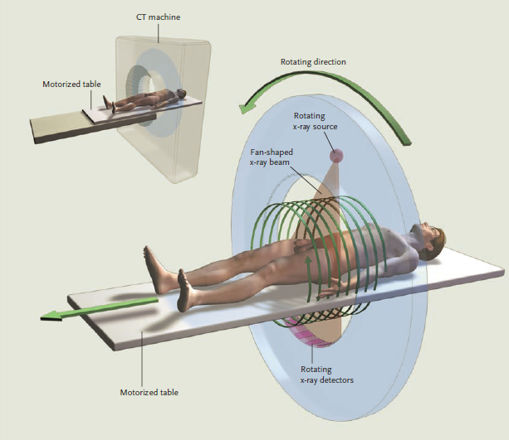
Spiral Single-slice CT

Slide 13
Full-scan Interpolation
z
y
x
Ray A
Full-scan projection data can be interpolated into a complete set of projection data on an imaging plane such as the x-y plane. The key is to find neighboring rays of the same orientation.

Slide 14
Half-scan Interpolation
z
y
x
Ray A
Half-scan projection data can be interpolated into a complete set of projection data on an imaging plane such as the x-y plane. The key is to find neighboring rays in the opposite orientations.

Slide 15
Retrospective Reconstruction
Direct
Reconstruction
Retrospective
Reconstruction
Scanning Loci
Slices
Scanning Locus
Slices
Incremental (Left) vs Spiral (Right) Scans Define Imaging Planes Differently. The Former Specifies Imaging Planes Physically/Prospectively, while the Latter Does so Computationally/Retrospectively.

Slide 16
Superior Detectability
Direct
Reconstruction
Retrospective
Reconstruction
Retrospective Reconstruction Gives Better Lesion Detectability If There Are Sufficiently Many Slices Reconstructed!

Slide 17
Theoretical Conclusion
“For a given X-ray dose, helical CT allows substantially better longitudinal resolution than conventional CT due to its inherent retrospective reconstruction capability.”
Wang and Vannier
Medical Physics 21:429-433, 1994

Slide 18
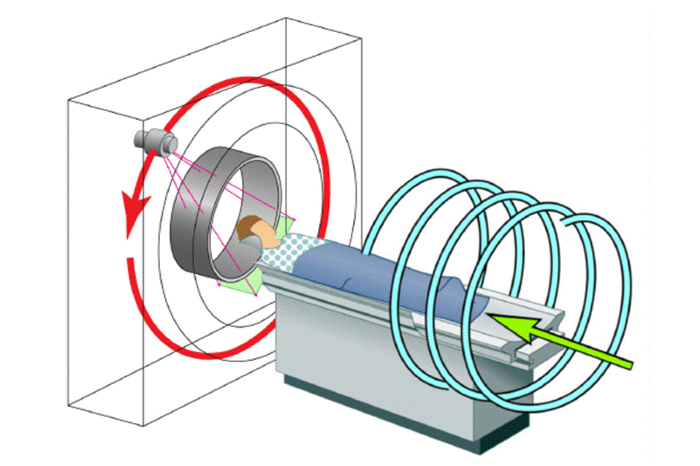
Spiral Multi-slice/Cone-beam CT
Wang, G, Lin, TH, Cheng PC, Shinozaki DM, Kim HG: Scanning cone-beam reconstruction algorithms for x-ray microtomography. Proc. SPIE 1556:99-112, July 1991
Wang G, Lin TH, Cheng PC, Shinozaki DM: A general cone-beam reconstruction algorithm. IEEE Trans. on Med. Imaging 12:486-496, 1993

Slide 19
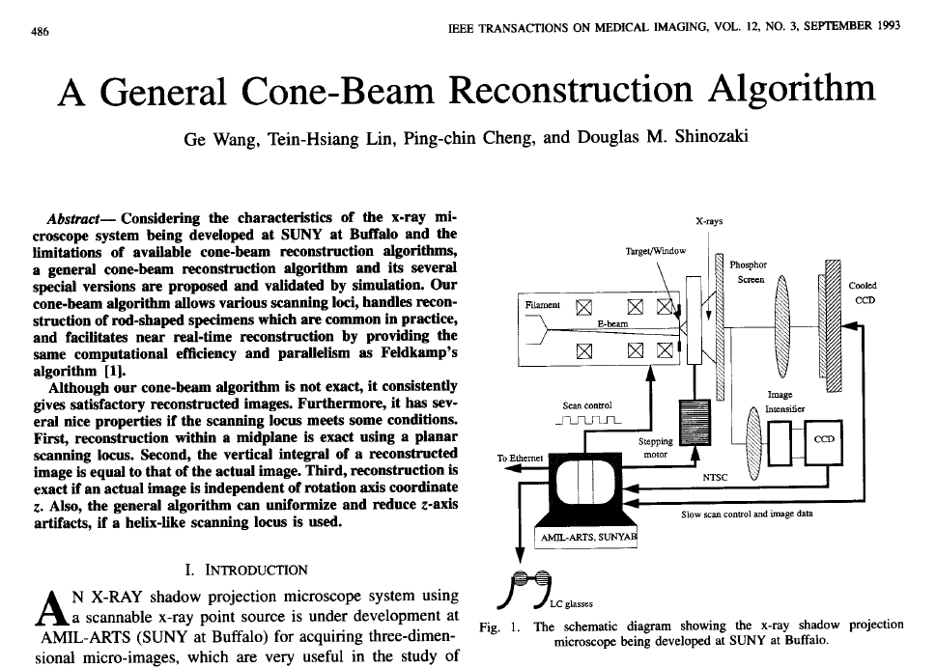

Slide 20
Citation Counts
To solve the long-object problem, a first level of improvement with respect to the 2D FBP algorithms was obtained by backprojecting the data in 3D, along the actual measurement rays. The prototype of this approach is the algorithm of Wang et al.
Defrise, Noo, Kudo: A solution to the long-object problem in helical cone-beam tomography. Phys. Med. Biol. 45:623-643, 2000
Many advances in CB reconstruction have been made recently thanks to the quest for an attractive reconstruction method in helical CB tomography.
Pack, Noo, Clackdoyle: Cone-beam reconstruction using the backprojection of locally filtered projections. IEEE Trans. Medical Imaging 24:1-16, 2005
100M Multi-slice/Cone-beam CT Scans Annually

Slide 21
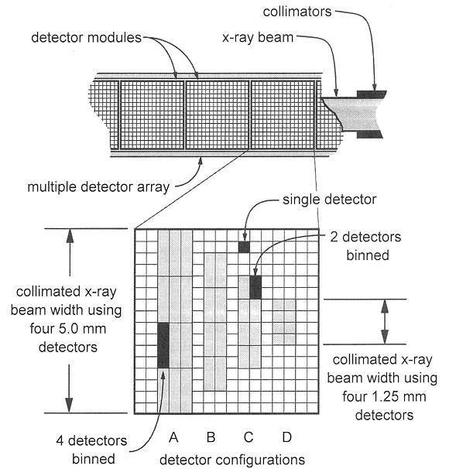
Longitudinal Data Truncation

Slide 22

Exact Spiral Cone-beam CT
Object
Source
Pi-Line
Detector
Plate
Katsevich A: An improved exact filtered backprojection algorithm for spiral computed tomography. Advances in Applied Math. 32: 681-697, 2004

Slide 23
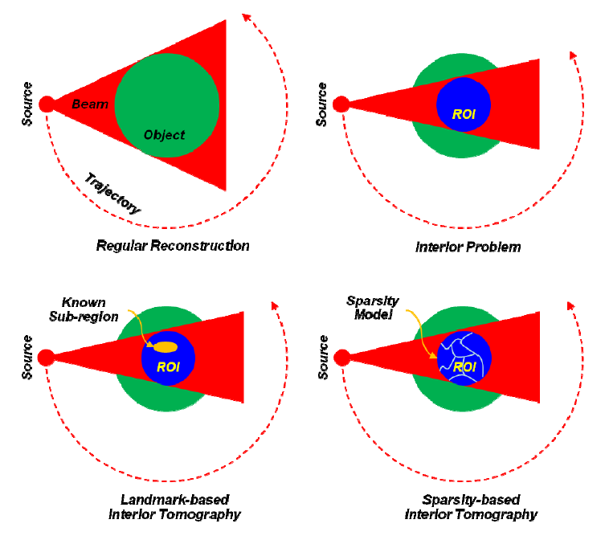
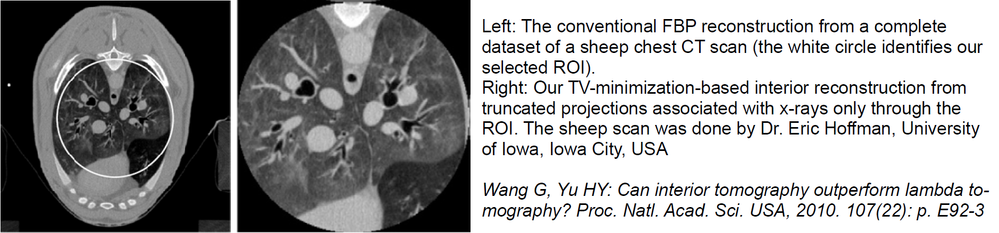
Transverse Data Truncation
X-rays

Slide 24
CT vs Interior Tomography
The Generic Interior Problem Has No Unique Solution in an Unconstrained Functional Space. An Additional Assumption is Needed:
(1) There Is a Small Sub-region Over Which CT Number is Known; or
(2) The Region of Interest (ROI) is Piecewise Polynomial, or
… …
All Data vs Partial Data (Truncated Both Sides)
Global vs Local Reconstruction
Whole Sale vs Retail
Door to New Opportunities
http://iopscience.iop.org/article/10.1088/0031-9155/58/16/R161/pdf

Slide 25


Interior Tomography
Line Integrals
Reconstruction
Detector Array
Sinogram
t
Object
X-rays
t
We Revisited the Long-Standing Interior Problem and Developed the Theory of Interior Tomography to Enable Exact Image Reconstruction over an Interior Region of Interest from Truncated Projection Data.

Slide 26
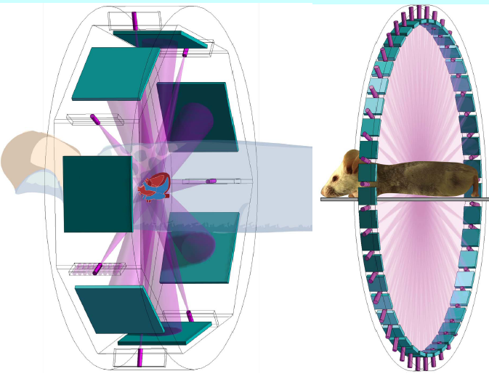
Less = Faster
Less =
Deeper understanding
Larger object
Less radiation dose
Finer image resolution
Wider dynamic range
… …
Faster imaging speed
Wang G, Yu HY, Ye YB: A scheme for multi-source interior tomography. Med. Phys. 36:3575-3581, 2009
Wang G: The meaning of interior tomography. Proc. of ICASSP, 5764-5767, 2011
Ritman EL, Kinsey JH, Robb RA, Gilbert BK, Harris LD, Wood EH: Three-dimensional image of the heart, lungs, and circulatory. Science 210:273-280, 1980

Slide 27
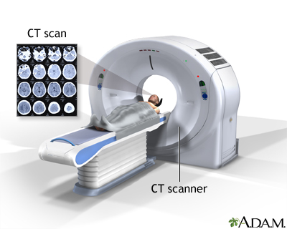
CT Scanner Architecture

Slide 28
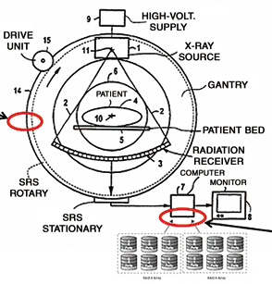
Typical Diagram

Slide 29
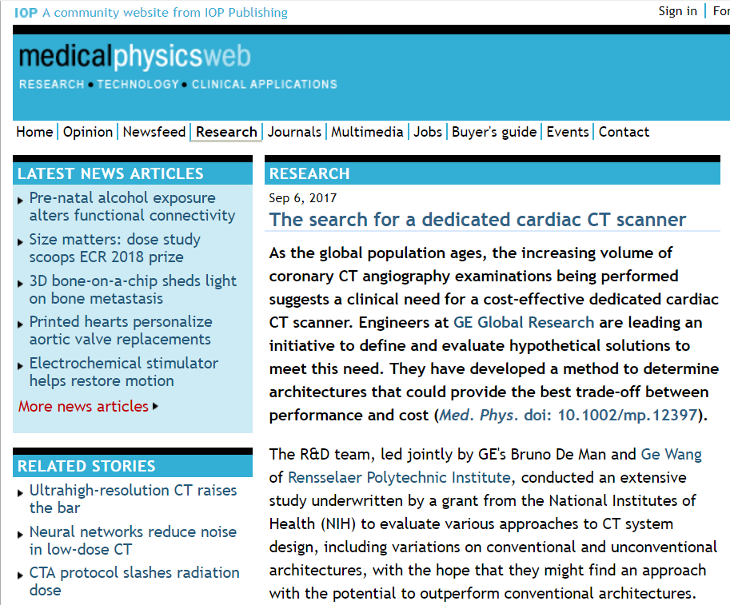

Slide 30
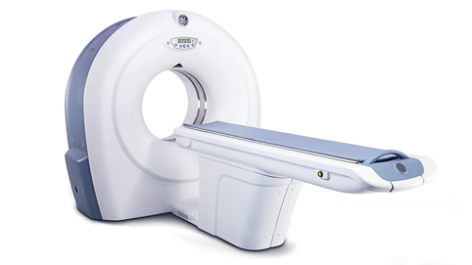
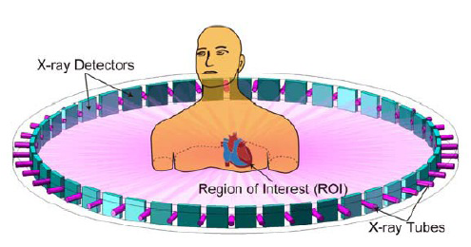
Cardiac CT Architecture
Background from Best Conventional CT
ROI Info from Spectral Interior Tomography
In-vivo Spectral Micro-CT Enabled with
– Parallel Localized Data Acquisition
– Hybrid Advanced Reconstruction

Slide 31
CT Scanner
Data Truncation
CT Scanning
CT Generations
Spiral/Helical CT
Interior Tomography
CT Image Artifacts
Image Quality
Image Artifacts
X-ray Radiation Dose
Dose Measures
Low-dose CT

Slide 32
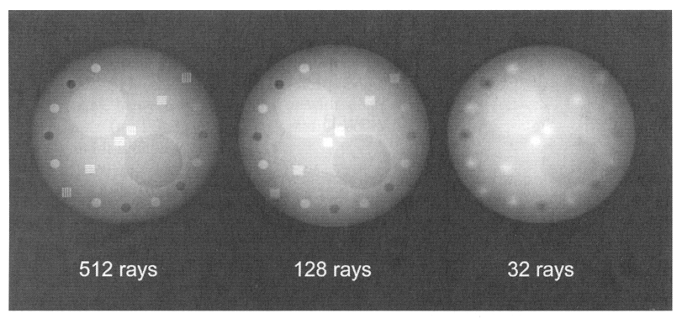
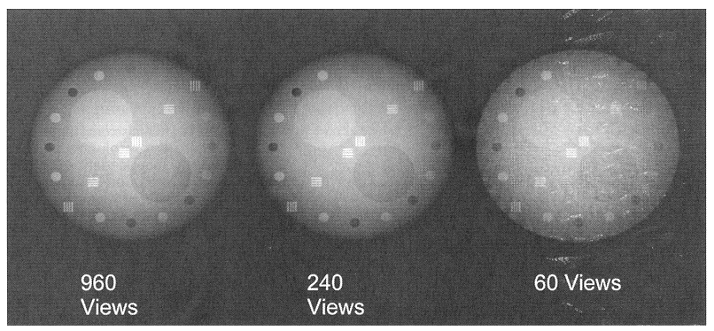
Data Sampling
~1K Rays per View, ~1K Views
Cross-sectional Image: 512x512 Pixels, ~4K Levels

Slide 33
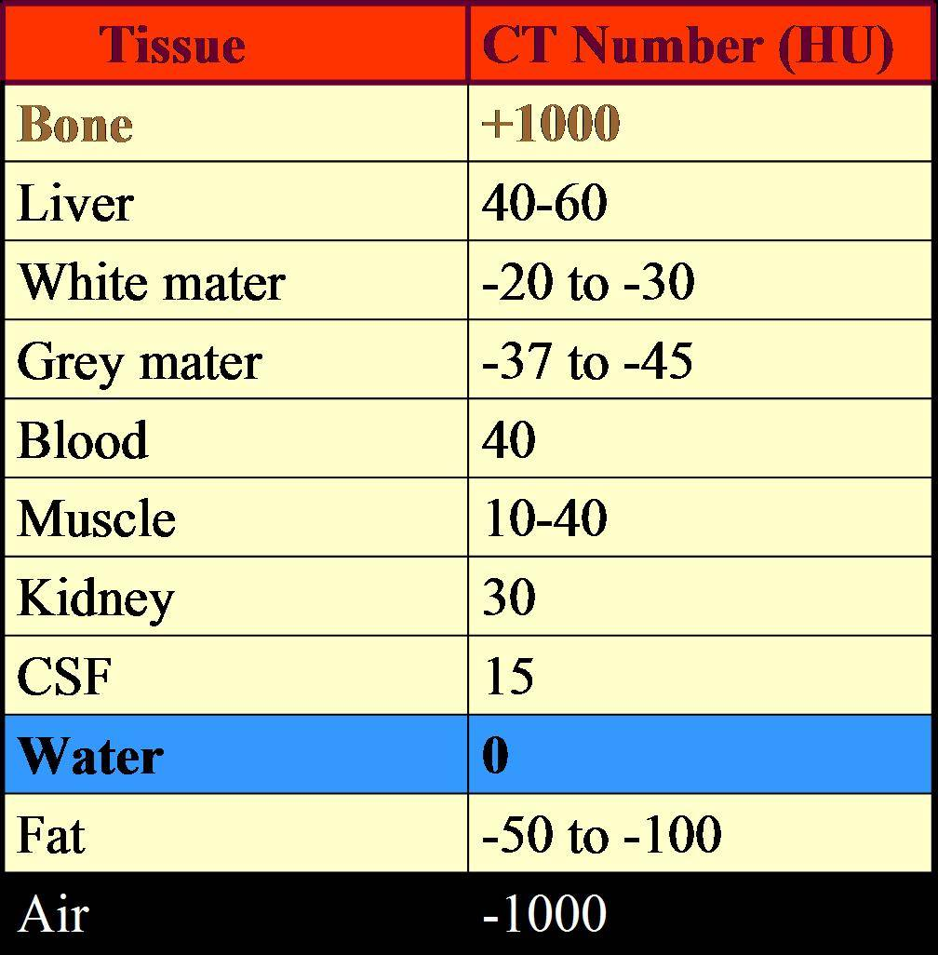
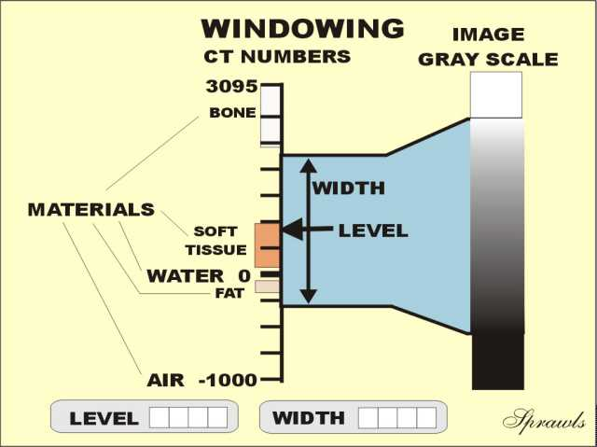
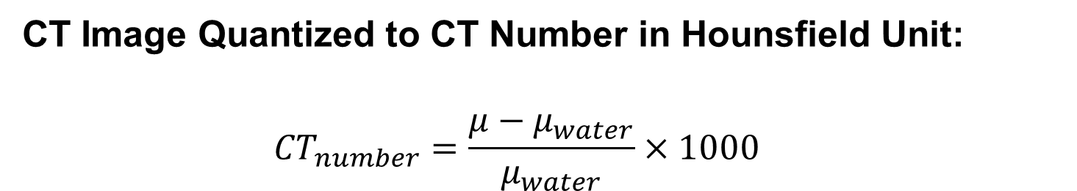
CT Number
CT Image Quantized to CT Number in Hounsfield Unit:
$${CT}_{number}=\frac{μ−μ_{water}}{μ_{water}}×1000$$

Slide 34
Examples

Slide 35
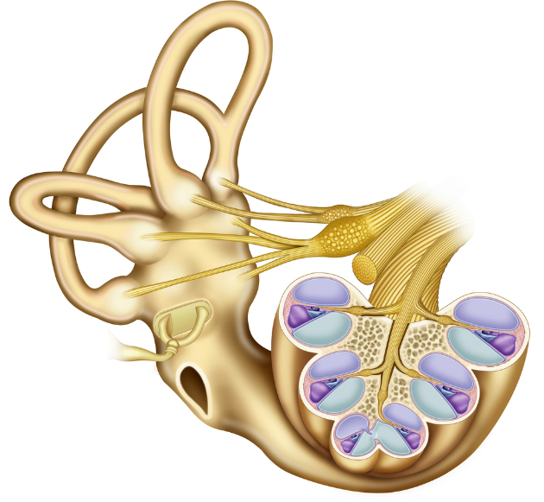
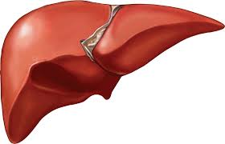

Image Resolution
High-contrast
- Distinguish small objects
adjacent to each other
Low-contrast
- Differentiate regions
similar in gray-level
Temporal resolution
- Capture time-varying structures

Slide 36
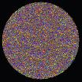
Image Noise
Due to Quantum and Other Random Effects
Depending on
Collimation
Tube Voltage
mAs Product
Patient Size
HVL for Water 3.6 cm
Voxel Size
Algorithm

Slide 37
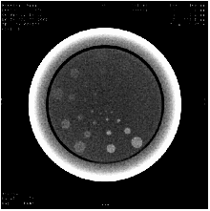
Low-contrast Resolution
Depending on
Object Size
Object Contrast
System MTF
System SSP
Image Noise

Slide 38
Temporal Resolution
Depending on
Scanning speed
Reconstruction method
Conventional Scanning
Spiral Scanning
(From JA Brink at Yale U)
Through-plane motion artifacts are
suppressed by single-breath-hold spiral scanning

Slide 39
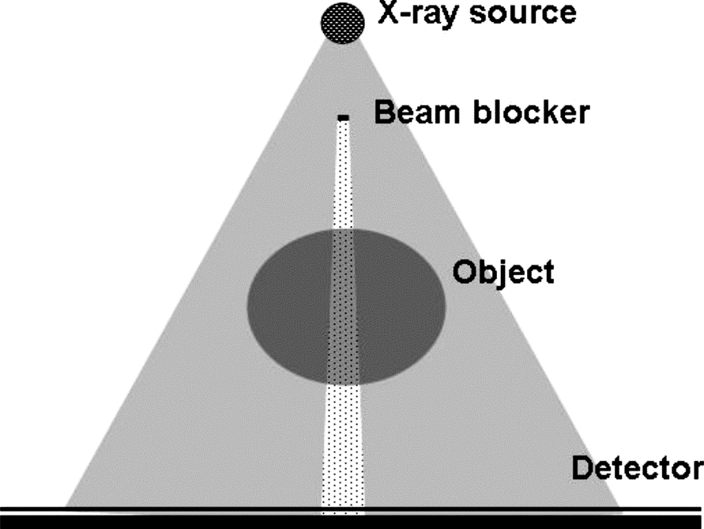
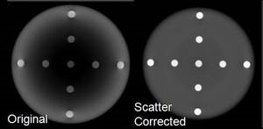
Scatter Artifacts
Randomly Scattered X-ray Photons Can Reach Detectors, Forming a Cloudy Background to Compromise Contrast Resolution. Anti-scatter Grid and/or Software Correction are Needed.

Slide 40
Beam-hardening
KeV
KeV
KeV
X-ray path
Longer X-ray Path/Stronger X-ray Attenuation Decreases Low Energy Components More Than High Energy Counterparts, Making the X-ray Spectrum Harder (Higher Energy in Greater Portion) after the Attenuation Process.

Slide 41
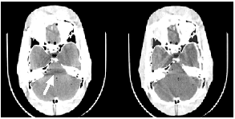
Beam-hardening Artifacts
Without correction
With correction
(From J Hsieh at GE)

Slide 42
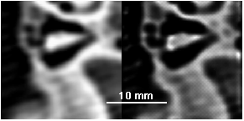
Volume Averaging
Volume averaging
Blurred
Deblurred
(Blurred data from GH Esselman at Wash U)
Finite Focal Spot, Finite Detector Aperture, Finite Pixel Size, and Many Other Factors Blur Structural Details.

Slide 43
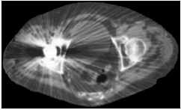
Metal Artifacts
(From DD Robertson at Wash U)
Metal Parts Cause Strong Beam-hardening and Severe Photon Starvation (Few Photons Arriving at Detectors, Leading to a High Level of Statistical Noise).

Slide 44

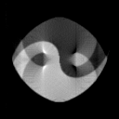


Motion Artifacts
θ=0º
Filtered
Backprojection
Iterative
Reconstruction with
Known Motion Pattern
θ=90º
Time-varying Phantom
Motion Artifacts Come from Model Mismatch. An Underlying Structure Keeps Changing While Data Are Collected. The Motion Pattern Can be Taken into Account for Accurate Reconstruction!

Slide 45
CT Scanner
Data Truncation
CT Scanning
CT Generations
Spiral/Helical CT
Interior Tomography
CT Image Artifacts
Image Quality
Image Artifacts
X-ray Radiation Dose
Dose Measures
Low-dose CT

Slide 46
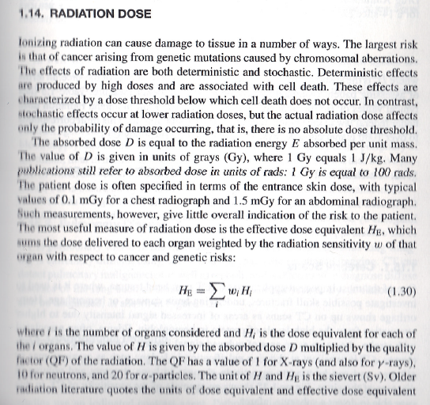

Slide 47
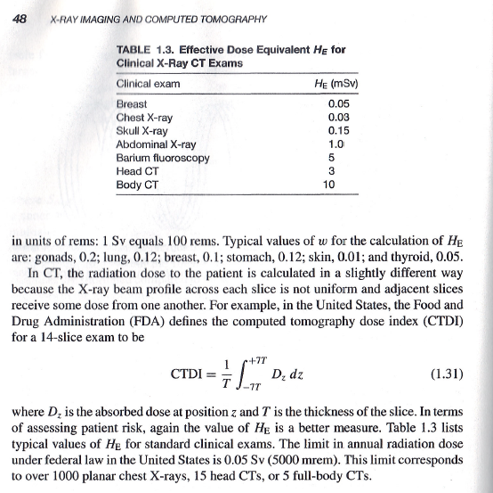

Slide 48
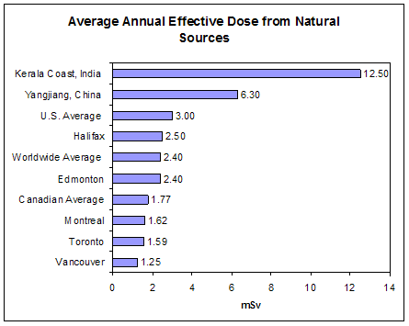
Natural Reference
http://nuclearsafety.gc.ca/images/radiation-information/graph-average-annual-effective-dose-natural-sources.gif

Slide 49
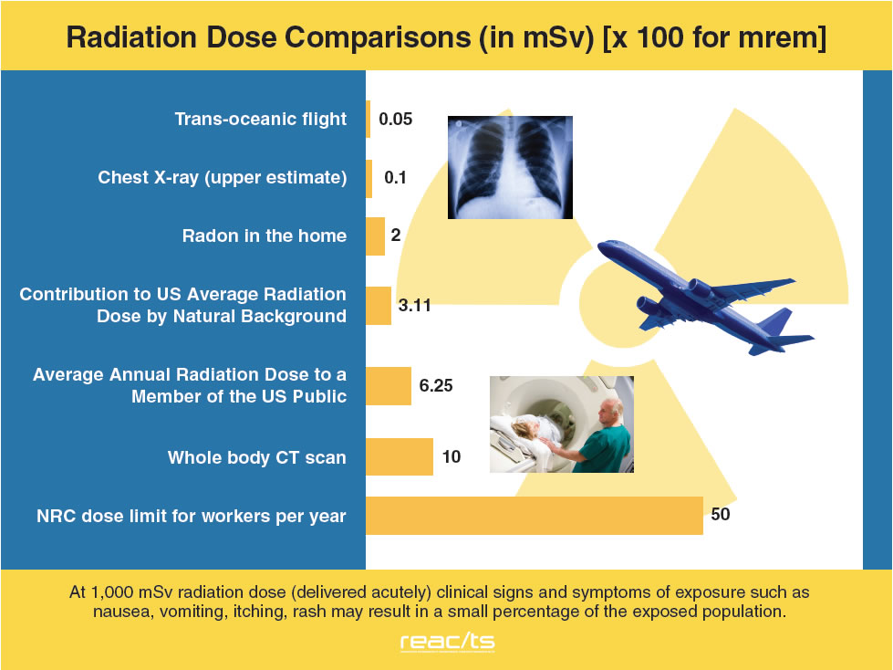

Slide 50
Radiation Dose
Absorbed Dose - Radiation Energy
Effective Dose – Organ Sensitivity
Dose Equivalent – Beam Quality

Slide 51
Radiation Profile: Single Scan
Ideal profile
Real profile
Radiation spreads outside
the designated slice due to scattering

Slide 52
CT Dose Index (CTDI)
CTDI: CT dose index
T: slice thickness
D(z): local dose
z: longitudinal coordinate
T

Slide 53
Radiation Profile: Multiple Scans
Real profile
Radiation Dose from Multiple Scans Are
Accumulated in the Central Slice

Slide 54
Multiple Scan Average Dose (MSAD)
I
MSAD: multiple scan average dose
I: inter-slice distance
N: Number of scans

Slide 55
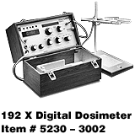
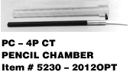
Dose Measurement
Cylindrical Phantoms of 16 cm & 32 cm
Pencil Ionization Chamber
Dosimeter
16 or 32 cm

Slide 56
MSAD Estimation
MSAD is
Directly Proportional to mA
Directly Proportional to Scan Time
Increases with kVp
Increases Slightly as Slice Thickness Decreases
Similar at the Iso-center and Near Surface for Head
Significantly Less at the Iso-center than
Near Surface for Body

Slide 57
Low-dose CT Roadmap (2012)

Slide 58
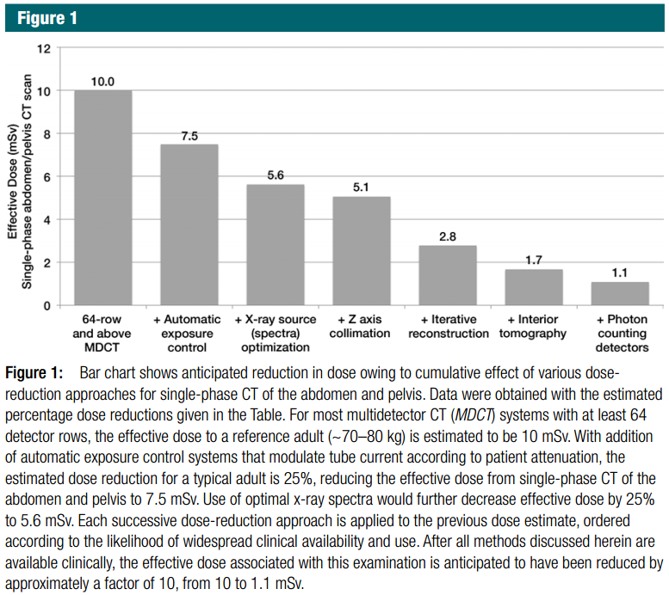

Slide 59
BB14 Homework
Green Book
1.14, 1.15 and 1.18
Optional:
As an Art_X Project, Please Design Portable CT Scanner in an Auto-driving Car, or a CT Scanner for a Novel Application.
Due Date: Same (1 Working Week Later)
Enjoy Spring Break!

Slide 60
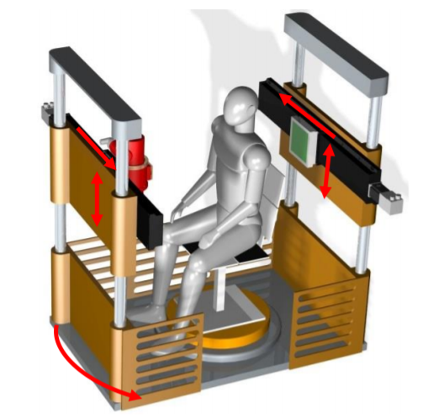
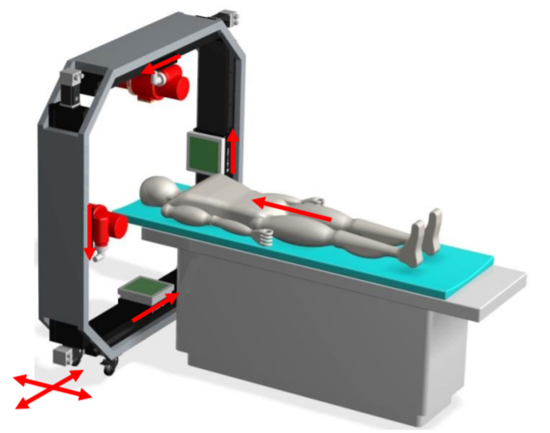
Two Examples
https://arxiv.org/ftp/arxiv/papers/1312/1312.6046.pdf
http://content.iospress.com/articles/journal-of-x-ray-science-and-technology/xst00453

